Slide 1

Tuples in Python

Slide 2
Python Tuples: Introduction
Tuples are very similar to lists, except that they are immutable (they cannot be changed).
They are created using parentheses – ( ), rather than square brackets – [ ].
We generally use tuple for heterogeneous (different) datatypes and list for homogeneous (similar) datatypes.
Since tuple are immutable, iterating through tuple is faster than with list. So there is a slight performance boost.
Tuples that contain immutable elements can be used as
Key for a dictionary. With list, this is not possible.
For data we can use them as the column keys as they will stay fixed.
If you have data that doesn't change, implementing it as tuple will guarantee that it remains write-protected.

Slide 3
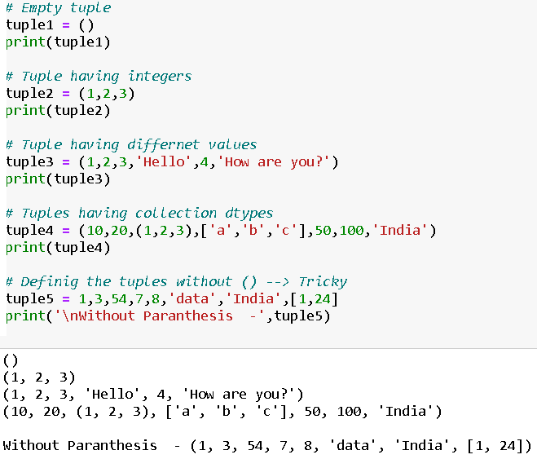
Creating a Tuple
A tuple is created by placing all the items (elements) inside a parentheses (), separated by comma.
The parentheses are optional but is a good practice to write it.
A tuple can have any number of items and they may be of different types (integer, tuple, list, string etc.).

Slide 4
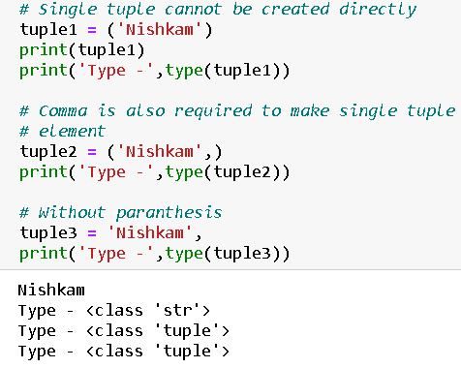
Creating a tuple with one element is a bit tricky.
Having one element within parentheses is not enough. We will need a trailing comma to indicate that it is in fact a tuple
Creating Tuples

Slide 5
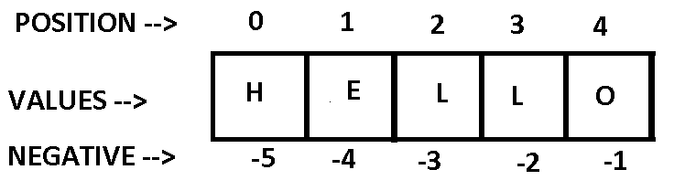
About Item Positioning
Or Reverse indexing

Slide 6
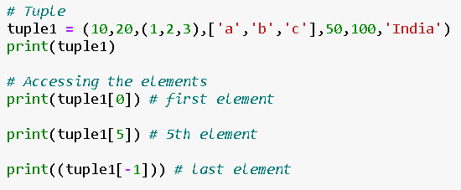


Accessing the elements of the tuple or Indexing
You can access the values in the tuple with their index.
Nested tuple are accessed using nested indexing
Negative indexing can be applied to tuples similar to lists.

Slide 7
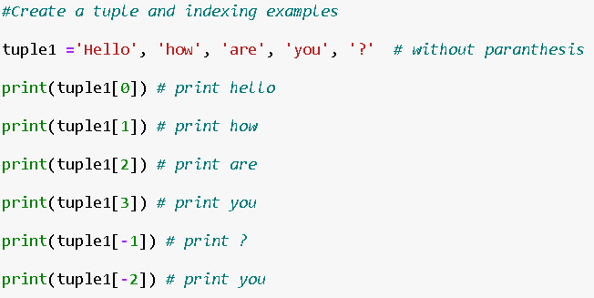

Indexing Operations

Slide 8
Exercise –
Create a tuple named ‘tuple1’.
Assign the values
→ tuple1 = (12,2,5,3,56,4,76,6,587,65,85,42,13,[‘a’,’b’])
Fetch the elements in order as follows:
First Element - 12
Largest Element - 587
Smallest Element – 2
Last Element – [‘a’,’b’] (with/without negative indexing)
Middle element – 76

Slide 9
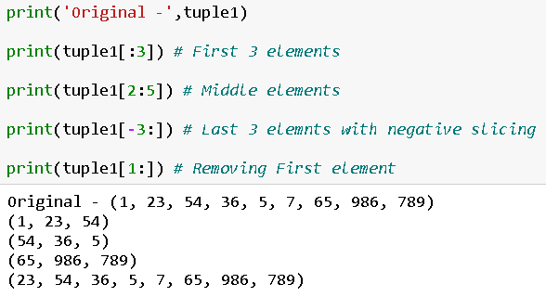
Slicing in Tuple
Slicing of a Tuple is done to fetch a specific set or slice of sub-elements from a Tuple. Slicing can also be done to other collection data types such as lists and arrays.
We can access a range of items in a tuple by using the slicing operator.

Slide 10

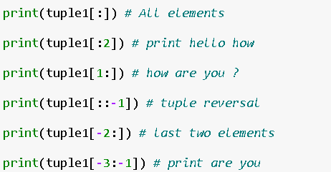
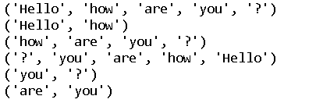
Slicing operations
→ tuple_name[start : stop : step]
Start : start point of tuple
Stop : endpoint of tuple
Step : skipping the item in between

Slide 11
Exercise –
Create a tuple named ‘tuple1’.
→ tuple1 = (12,2,5,3,56,4,76,6,587,65,85,42,13)
Fetch the elements in order as follows:
First 5 Elements
Last 2 Elements - (with/without negative indexing)
Get the o/p –
(5,3,56,4)
(76,6,587)
(65,85,42,13)
(65,85,42,13)
(13,42,85,65) - reverse

Slide 12
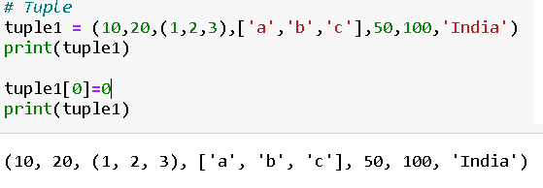
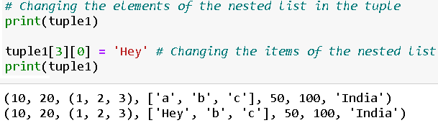
Changing the tuple
Unlike lists, tuples are immutable.
This means that elements of a tuple cannot be changed once it has been assigned. But, if the element is itself a mutable datatype like list, its nested items can be changed.

Slide 13
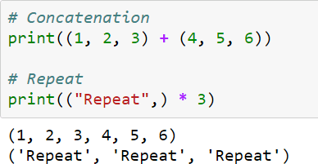
Tuple concatenation/repetition
Similar to List,
We can use + operator to combine two tuples. This is also called concatenation.
We can also repeat the elements in a tuple for a given number of times using the * operator.
Both + and * operations result into a new tuple.

Slide 14
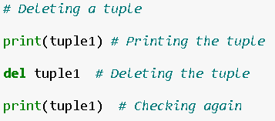
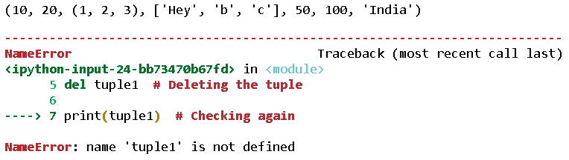
Deleting a Tuple
We cannot change the elements in a tuple. That also means we cannot delete or remove items from a tuple.
But deleting a tuple entirely is possible using the keyword del.

Slide 15
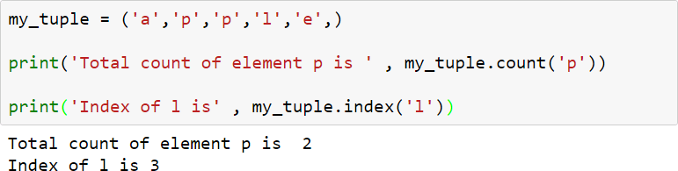
Python Tuple Methods
Methods that add items or remove items are not available with tuple.
Only the following two methods are available.
Method | Description
count(x) | Return the number of items that is equal to x
index(x) | Return index of first item that is equal to x

Slide 16
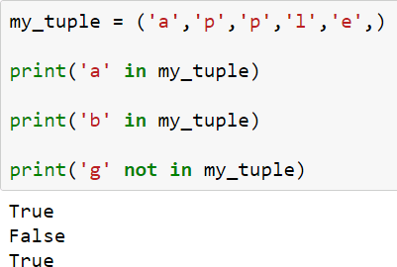
We can test if an item is present in the tuple or not using the keyword “in”.
Tuple Membership

Slide 17
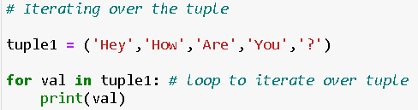

Using a for loop we can iterate though each item in a tuple.
Iterating through a tuple

Slide 18
Built-in Functions with Tuple
Function | Description
all() | Return True if all elements of the tuple are true (or if the tuple is empty).
any() | Return True if any element of the tuple is true. If the tuple is empty, return False.
enumerate() | Return an enumerate object. It contains the index and value of all the items of tuple as pairs.
len() | Return the length (the number of items) in the tuple.
max() | Return the largest item in the tuple.
min() | Return the smallest item in the tuple
sorted() | Take elements in the tuple and return a new sorted list (does not sort the tuple itself).
sum() | Retrun the sum of all elements in the tuple.
tuple() | Convert an iterable (list, string, set, dictionary) to a tuple.

